Slide 1
*Expounding: to explain by setting forth in careful and often deliberate detail
*Melancholy: a depression of the spirits; sadness; dejection
*Devoid: empty; not having or using; lack of
*Nocturnal: of, relating to, or occurring at night
*Lucidity: clearness of thought; a capacity to perceive the truth instantaneously

Slide 2
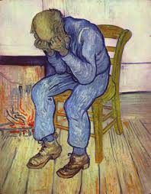
Which Vocab Word?

