Slide 1
*Compulsory: mandatory; enforced
*imperceptibly: subtly; barely noticeable; not obviously
*lamentation: audible expression of sorrow, grief *countenance: face; visage; aspect
*emaciated: wasted away physically; feeble; thin

Slide 2
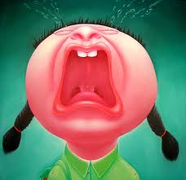
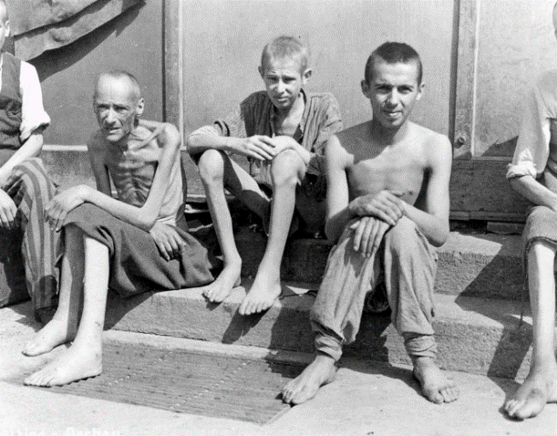
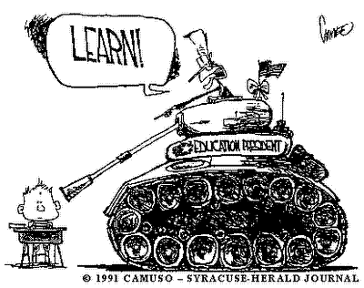
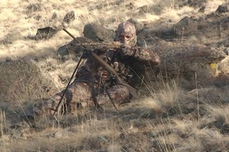
Which vocab word?

