Slide 1
*derision: state of being ridiculed or scorned; open dislike & disrespect
*indeterminate: not definitely or precisely fixed; vague; subtle
*encumbrance: a burden; a hindrance
*appeasing: causing to subside; bringing to a state of peace or quiet
*inert: lacking the power to move; sluggish

Slide 2
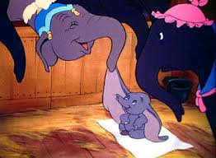
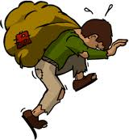
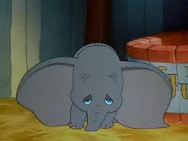
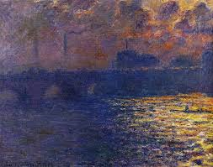
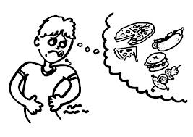
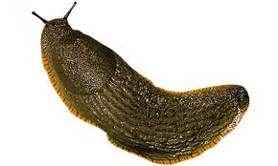
grrrrr

